Slide 1
Pointer

Slide 2
Definition
A pointer is a variable whose value is the address of another variable, i.e., direct address of the memory location. Like any variable or constant, you must declare a pointer before using it to store any variable address.
The general form of a pointer variable declaration is :
type *var-name;

Slide 3
Valid pointer declarations
int *ip; /* pointer to an integer */
double *dp; /* pointer to a double */
float *fp; /* pointer to a float */
char *ch /* pointer to a character */

Slide 4
Pointer Notation
Consider the declaration,
int x = 32 ;
This declaration tells the C compiler to:
(a) Reserve space in memory to hold the integer value.
(b) Associate the name x with this memory location.
(c) Store the value 32 at this location.

Slide 5
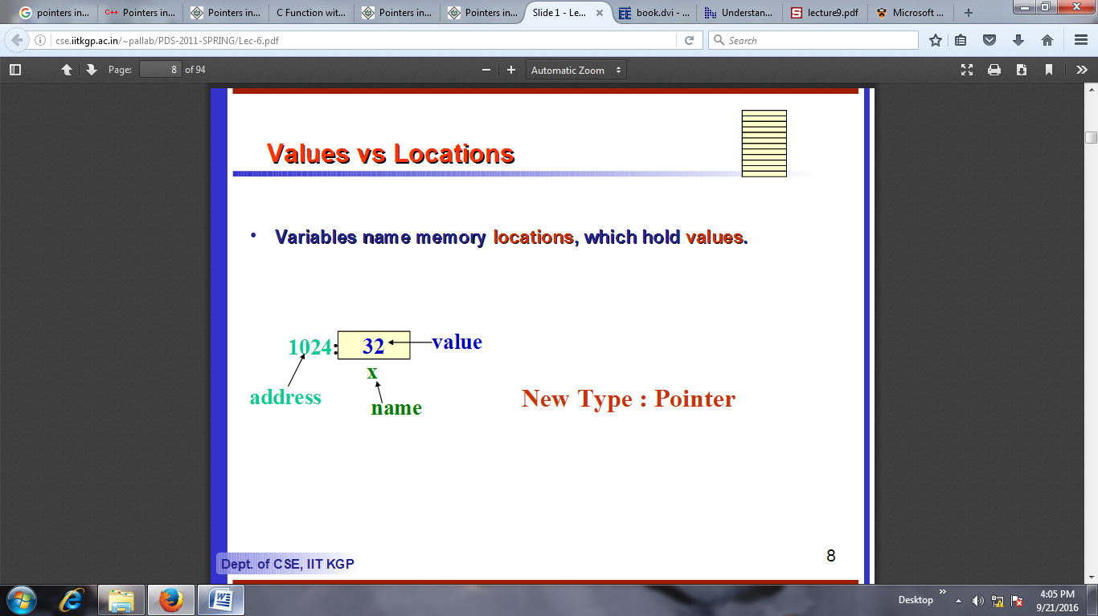

Slide 6
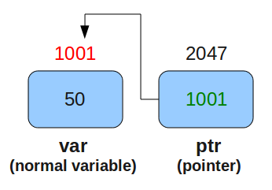
Example
int var=50;
int *ptr;
ptr=&var;
Above mentioned three lines means:

Slide 7
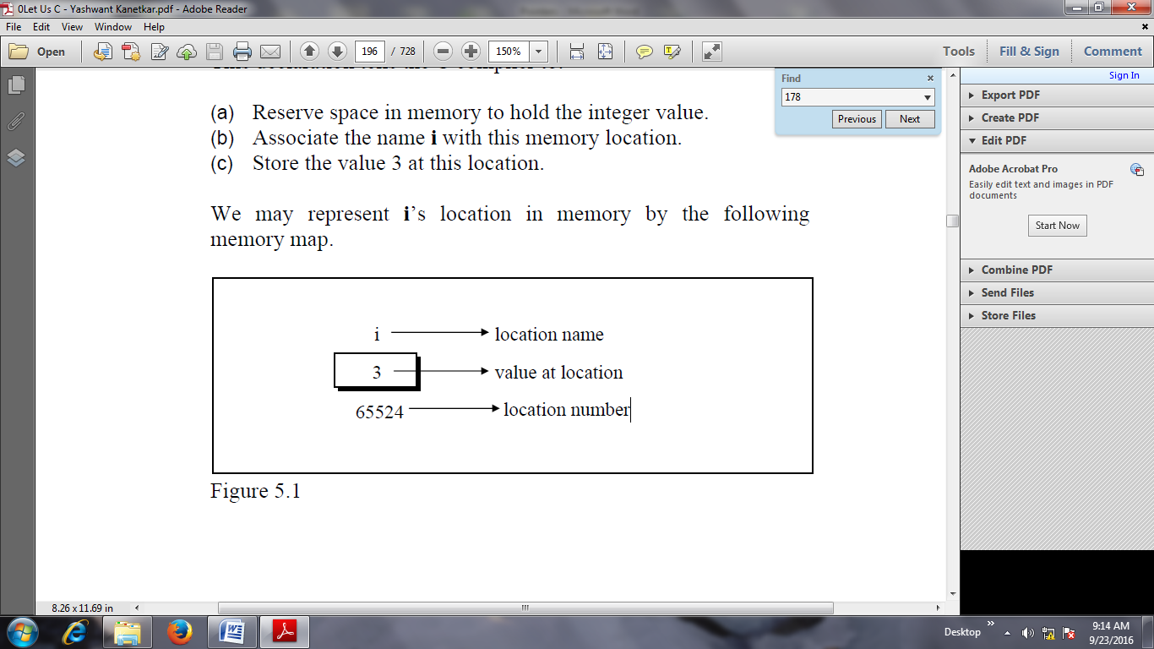
Example:
main( )
{
int i = 3 ;
printf ( "\nAddress of i = %u", &i ) ;
printf ( "\nValue of i = %d", i ) ;
}
Output:
Address of i = 65524
Value of i = 3

Slide 8
Initialization of Pointer variable
Pointer Initialization is the process of assigning address of a variable to pointer variable. address operator & is used to determine the address of a variable.
int a = 10 ;
int *ptr ; //pointer declaration
ptr = &a ; //pointer initialization

Slide 9
Pointer variable always points to same type of data.
float a;
int *ptr;
ptr = &a; //ERROR, type mismatch

Slide 10
Example:
void main()
{
int* pc;
int c;
c=22;
printf("Address of c:%d\n", &c);
printf("Value of c:%d\n\n", c);
pc=&c;
printf("Address of pointer pc:%d\n", pc); printf("Content of pointer pc:%d\n\n",*pc);
}

Slide 11
Example:
main( )
{
int i = 3 ;
int *j ;
j = &i ;
printf ( "\nAddress of i = %u", &i ) ;
printf ( "\nAddress of i = %u", j ) ;
printf ( "\nAddress of j = %u", &j ) ;
printf ( "\nValue of j = %u", j ) ;
printf ( "\nValue of i = %d", i ) ;
printf ( "\nValue of i = %d", *( &i ) ) ;
printf ( "\nValue of i = %d", *j ) ;
}

Slide 12
Output
Address of i = 65524
Address of i = 65524
Address of j = 65522
Value of j = 65524
Value of i = 3
Value of i = 3
Value of i = 3

Slide 13
Pointer to a pointer
A pointer to a pointer is a form of multiple indirection, or a chain of pointers. Normally, a pointer contains the address of a variable.
When we define a pointer to a pointer, the first pointer contains the address of the second pointer, which points to the location that contains the actual value as shown below.
A variable that is a pointer to a pointer must be declared as such. This is done by placing an additional asterisk in front of its name. For example, the following declaration declares a pointer to a pointer of type int –
int **var;

Slide 14
Example 1:
void main ()
{
int var;
int *ptr;
int **pptr;
var = 3000;
ptr = &var; /* take the address of var */
pptr = &ptr; /* take the address of ptr using address of operator & */
printf("Value of var = %d\n", var );
printf("Value available at *ptr = %d\n", *ptr );
printf("Value available at **pptr = %d\n", **pptr);
}

Slide 15
Output:
When the above code is compiled and executed, it produces the following result −
Value of var = 3000
Value available at *ptr = 3000
Value available at **pptr = 3000

Slide 16
Example 2:
main( )
{
int i = 3, *j, **k ;
j = &i ;
k = &j ;
printf ( "\nAddress of i = %u", &i ) ;
printf ( "\nAddress of i = %u", j ) ;
printf ( "\nAddress of i = %u", *k ) ;
printf ( "\nAddress of j = %u", &j ) ;
printf ( "\nAddress of j = %u", k ) ;
printf ( "\nAddress of k = %u", &k ) ;
printf ( "\nValue of j = %u", j ) ;
printf ( "\nValue of k = %u", k ) ;
printf ( "\nValue of i = %d", i ) ;
printf ( "\nValue of i = %d", * ( &i ) ) ;
printf ( "\nValue of i = %d", *j ) ;
printf ( "\nValue of i = %d", **k ) ;
}

Slide 17
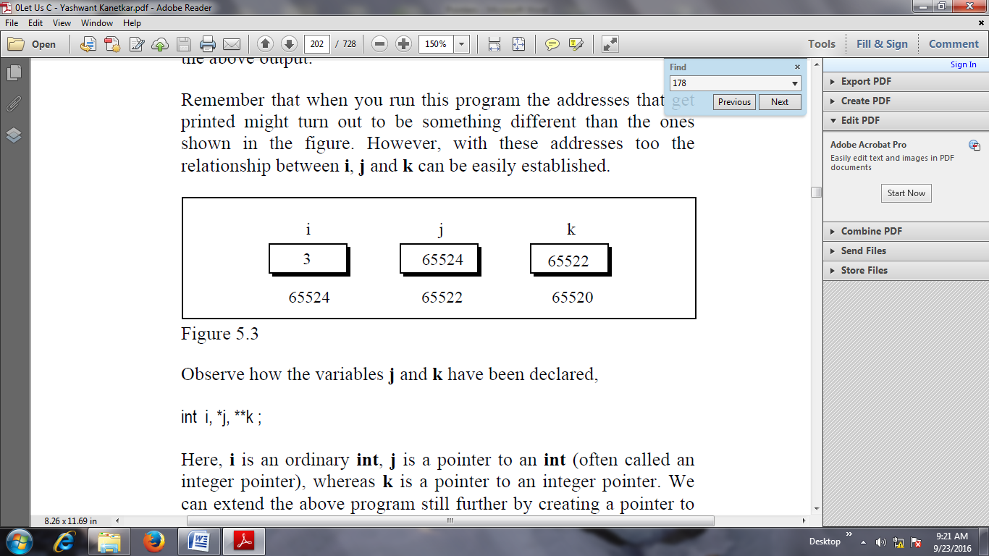

Slide 18
Output:
Address of i = 65524
Address of i = 65524
Address of i = 65524
Address of j = 65522
Address of j = 65522
Address of k = 65520
Value of j = 65524
Value of k = 65522
Value of i = 3
Value of i = 3
Value of i = 3
Value of i = 3

Slide 19
Reference operator(&) and Dereferencing operator(*)
The expression &i returns the address of the variable i, which in this case happens to be 65524. Once a pointer has been assigned the address of a variable.
To access the value of variable, pointer is dereferenced, using the indirection operator *. The other pointer operator available in C is ‘*’, called ‘value at address’ operator. It gives the value stored at a particular address. The ‘value at address’ operator is also called ‘indirection’ operator.

Slide 20
NULL Pointers
It is always a good practice to assign a NULL value to a pointer variable in case you do not have an exact address to be assigned.
This is done at the time of variable declaration.
A pointer that is assigned NULL is called a null pointer.
The NULL pointer is a constant with a value of zero defined in several standard libraries.

Slide 21
Example
#include <stdio.h>
void main ()
{
int *ptr = NULL;
printf("The value of ptr is : %x\n", ptr );
}
When the above code is compiled and executed, it produces the following result −
The value of ptr is 0.

Slide 22
Pointer and Arrays
When an array is declared, compiler allocates sufficient amount of memory to contain all the elements of the array.
Base address which gives location of the first element is also allocated by the compiler.

Slide 23
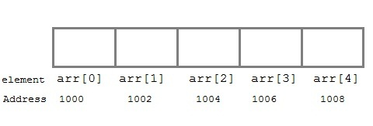
Example:
Suppose we declare an array arr,
int arr[5]={ 1, 2, 3, 4, 5 };
Assuming that the base address of arr is 1000 and each integer requires two byte, the five element will be stored as follows :

Slide 24
Here variable arr will give the base address, which is a constant pointer pointing to the element, arr[0].
Therefore arr is containing the address of arr[0] i.e 1000.
arr is equal to &arr[0] // by default

Slide 25
Pointer to Array
We can use a pointer to point to an Array, and then we can use that pointer to access the array.

Slide 26
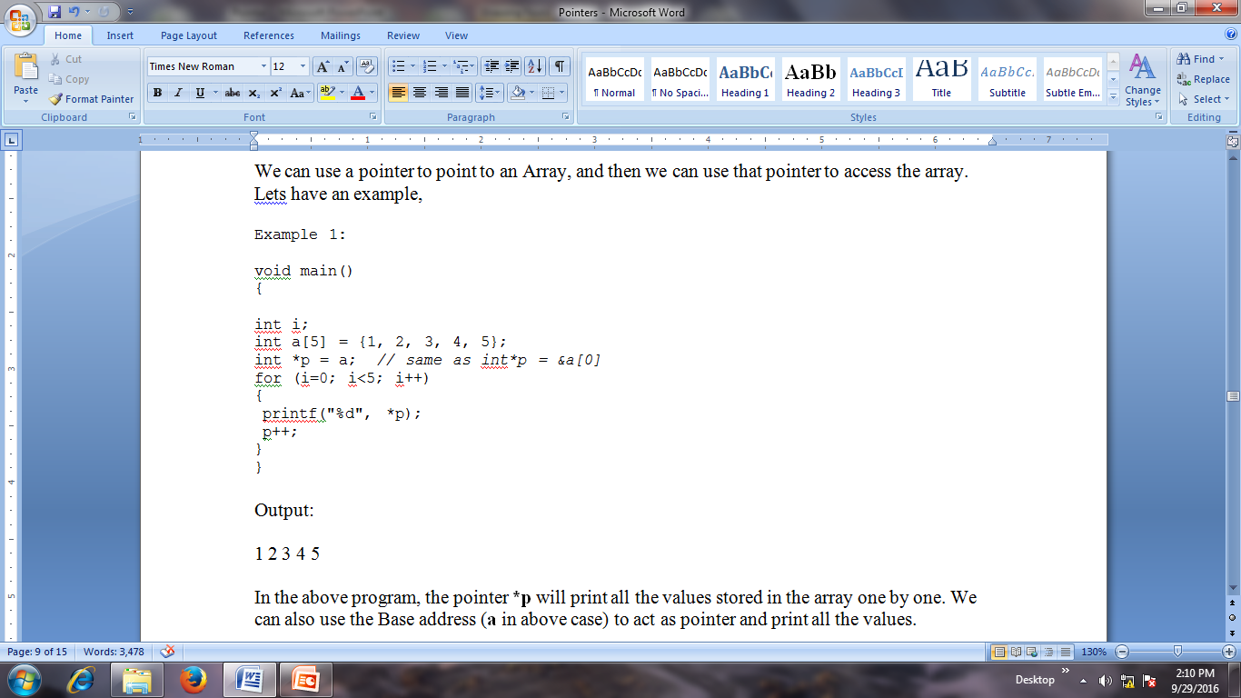
Example:

Slide 27
Array of Pointers
Many pointers can be combined to form an array.

Slide 28
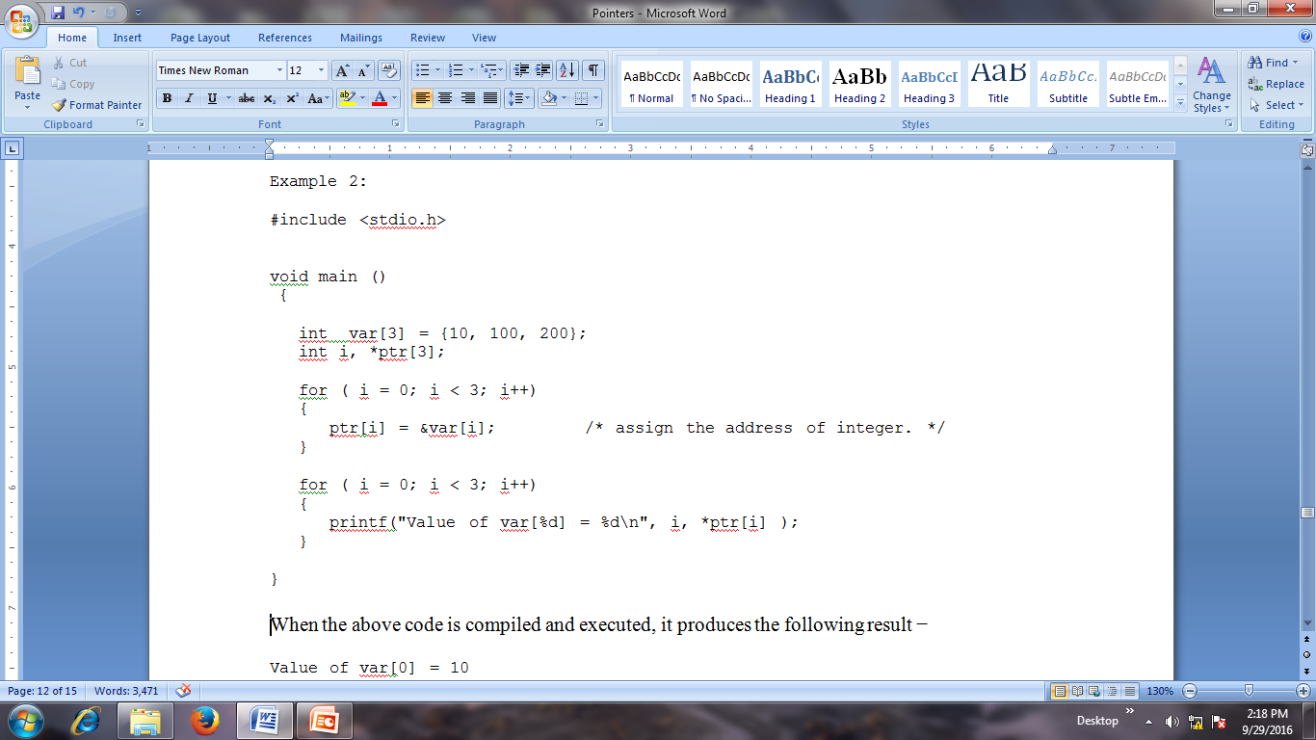
Example

Slide 29
Output:
Value of var[0] = 10
Value of var[1] = 100
Value of var[2] = 200

Slide 30
Wild Pointer
When a pointer points to an unallocated memory location, such a pointer is called a wild pointer.
The pointer becomes a wild pointer due to following reasons:
Pointer declared but not initialized
Accessing destroyed data

Slide 31
Example
int main()
{
int *p; /* wild pointer */
int a = 10;
p = &a; /* p is not a wild pointer now*/
}

Slide 32
Dangling pointer
A pointer pointing to a memory location that has been deleted (or freed) is called dangling pointer.
void main()
{
int *ptr = (int *)malloc(sizeof(int));
free(ptr);
// ptr becomes a dangling pointer
ptr = NULL;
// No more a dangling pointer
}

Slide 33
Void pointer
Void pointer is a specific pointer type – void * – a pointer that points to some data location in storage, which doesn’t have any specific type. Void refers to the type. Basically the type of data that it points to is can be any.
If we assign address of char data type to void pointer it will become char Pointer, if int data type then int pointer and so on.
Any pointer type is convertible to a void pointer hence it can point to any value.

Slide 34
Important Points
void pointers cannot be dereferenced.
It can however be done using typecasting the void pointer
Pointer arithmetic is not possible on pointers of void due to lack of concrete value and thus size.
(int*)ptr - does type casting of void
*((int*)ptr) dereferences the typecasted

Slide 35
Example
void main()
{
int x = 4;
float y = 5.5;
void *ptr; //A void pointer
ptr = &x; // void pointer is now int
printf("Integer variable is = %d", *( (int*) ptr) );
ptr = &y; // void pointer is now float
printf("\nFloat variable is= %f", *( (float*) ptr) );
}

Slide 36
Pointer Expressions
Like other variables, pointer variables can be used in expressions.
If p1 and p2 are two pointers, the following statements are valid:
sum = *p1 + *p2 ;
prod = *p1 * *p2 ;
prod = (*p1) * (*p2) ;
*p1 = *p1 + 2;
x = *p1 / *p2 + 5 ;

Slide 37
Incrementing Pointer
#include<stdio.h>
void main(){
int number=50;
int *p; //pointer to int
p=&number; //stores the address of number variable
printf("Address of p variable is %u \n",p);
p=p+1;
printf("After increment: Address of p variable is %u \n",p);
// in our case, p will get incremented by 4 bytes.
}

Slide 38
Incrementing Pointer in an array
#include<stdio.h>
void main ()
{
int ar[50], i;
int *p = ar;
printf(“Enter array elements...\n");
scanf(“%d“, &ar[i]);
printf("printing array elements...\n");
for(i = 0; i< 5; i++)
{
printf("%d ",*(p+i));
}
}

Slide 39
Decrementing Pointer
#include <stdio.h>
void main(){
int number=50;
int *p; //pointer to int
p=&number; //stores the address of number variable
printf("Address of p variable is %u \n",p);
p=p-1;
printf("After decrement: Address of p variable is %u \n",p);
// P will now point to the immidiate previous location.
}

Slide 40
Pointer Addition
#include<stdio.h>
void main(){
int number=50;
int *p;//pointer to int
p=&number; //stores the address of number variable
printf("Address of p variable is %u \n",p);
p=p+3; //adding 3 to pointer variable
printf("After adding 3: Address of p variable is %u \n",p);
}

Slide 41
Pointer Subtraction
#include<stdio.h>
void main(){
int number=50;
int *p;//pointer to int
p=&number;//stores the address of number variable
printf("Address of p variable is %u \n",p);
p=p-3; //subtracting 3 from pointer variable
printf("After subtracting 3: Address of p variable is %u \n",p);
}

Slide 42
Benefits(use) of pointers
Pointers provide direct access to memory
Pointers provide a way to return more than one value to the functions
Reduces the execution time of the program
Provides an alternate way to access array elements
Pointers allows us to perform dynamic memory allocation and de-allocation.
Pointers helps us to build complex data structures like linked list, stack, queues, trees, graphs etc.
Pointers allows us to resize the dynamically allocated memory block.

Slide 43
Drawbacks of pointers
Dynamically allocated block needs to be freed explicitly.
Otherwise, it would lead to memory leak.
Pointers are slower than normal variables.
If pointers are updated with incorrect values, it might lead to memory corruption.

Slide 44
Dynamic Memory Allocation

Slide 45
Basic Idea
Dynamic Memory Allocation can be defined as a procedure in which the size of a data structure (like Array) is changed during the runtime.
There are 4 library functions provided by C defined under <stdlib.h> header file to facilitate dynamic memory allocation in C programming.
They are:
malloc() – memory allocation
calloc()- contiguous allocation
free()
realloc() – re-allocation

Slide 46
Malloc()
“malloc” or “memory allocation” method is used to dynamically allocate a single large block of memory with the specified size.
It returns a pointer of type void which can be cast into a pointer of any form.
It initializes each block with default garbage value.
Syntax:
ptr = (cast-type*) malloc(byte-size)
ptr = (int*) malloc(100 * sizeof(int));
Since the size of int is 4 bytes, this statement will allocate 400 bytes of memory.
And, the pointer ptr holds the address of the first byte in the allocated memory.

Slide 47
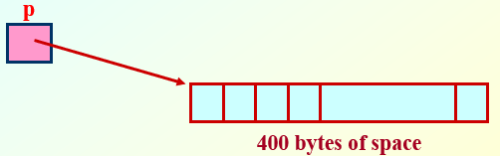
Examples
p = (int *) malloc (100 * sizeof (int)) ;
A memory space equivalent to “100 times the size of an int” bytes is reserved.
The address of the first byte of the allocated memory is assigned to the pointer p of type int.

Slide 48
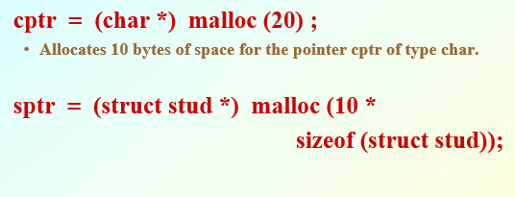
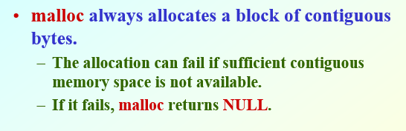

Slide 49
Example
#include <stdio.h>
main()
{
int i,N;
float *height;
float sum=0,avg;
printf("Input the number of students. \n");
scanf("%d",&N);
height=(float *) malloc(N * sizeof(float));

Slide 50
printf("Input heights for %d
students \n",N);
for(i=0;i<N;i++)
scanf("%f",&height[i]);
for(i=0;i<N;i++)
sum+=height[i];
avg=sum/(float) N;
printf("Average height= %f \n",
avg);
}

Slide 51
Output
Input the number of students.
5
Input heights for 5 students
23 24 25 26 27
Average height= 25.000000

Slide 52
Calloc()
The calloc() in C is a function used to allocate multiple blocks of memory having the same size.
It is a dynamic memory allocation function that allocates the memory space to complex data structures such as arrays and structures and returns a void pointer to the memory.
Calloc stands for contiguous allocation.

Slide 53
Example
#include<stdio.h
#include<stdlib.h>
void main(){
int n,i,*ptr,sum=0;
printf("Enter number of elements: ");
scanf("%d",&n);
ptr=(int*)calloc(n,sizeof(int)); //memory allocated using calloc
if(ptr==NULL)
{
printf("Sorry! unable to allocate memory");
exit(0);
}
printf("Enter elements of array: ");
for(i=0;i<n;++i)
{
scanf("%d",ptr+i);
sum+=*(ptr+i);
}
printf("Sum=%d",sum);
free(ptr);
getch(); }

Slide 54
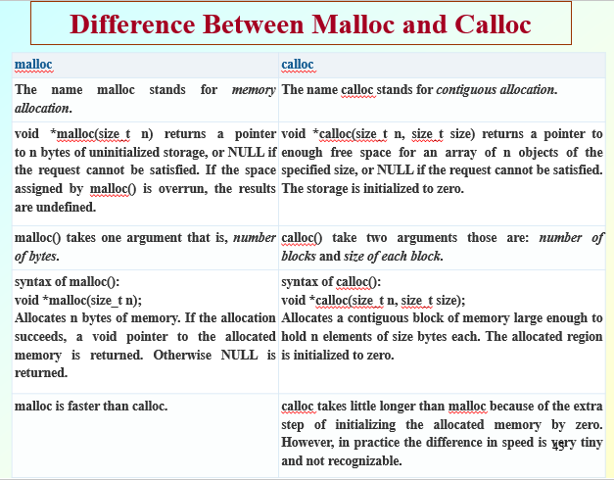

Slide 55

realloc
Size of dynamically allocated memory can be changed by using realloc().
realloc deallocates the old object pointed to by ptr and returns a pointer to a new object that has the size specified by size. The contents of the new object is identical to that of the old object prior to deallocation, up to the lesser of the new and old sizes. Any bytes in the new object beyond the size of the old object have indeterminate values. The point to note is that realloc() should only be used for dynamically allocated memory. If the memory is not dynamically allocated, then behavior is undefined.

Slide 56
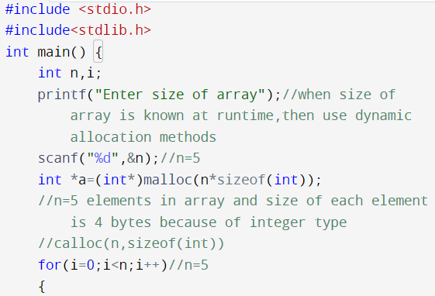
realloc

Slide 57
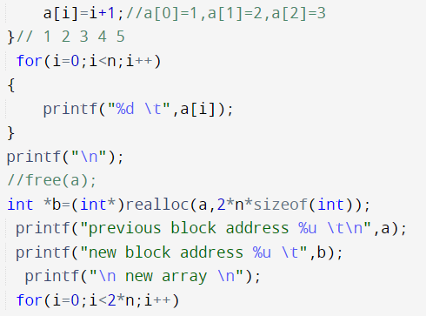

Slide 58
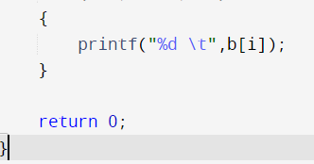
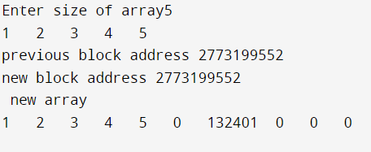

Slide 59
n = 10;
printf("\n\nEnter the new size of the array: %d\n", n);
ptr = realloc(ptr, n * sizeof(int));
printf("Memory successfully re-allocated using realloc.\n");
for (i = 5; i < n; ++i) {
ptr[i] = i + 1;
}
printf("The elements of the array are: ");
for (i = 0; i < n; ++i) {
printf("%d, ", ptr[i]);
}
free(ptr);
}
return 0;
}

